Slide 1
Text based book classification
Aaron Kohn

Slide 2
INTRODUCTION
Categorize books using the actual text.
Predict book name based on samples of text.
Predict author based off text samples.

Slide 3
The data has been collected from Project Gutenberg and the following features extracted. Name Author Length and 10 Text samples

Slide 4
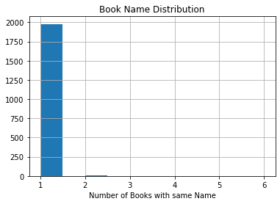

Slide 5
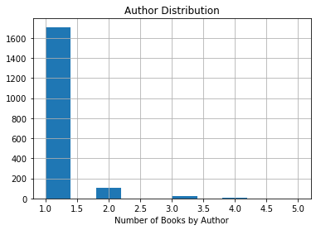

Slide 6
Steps
10 samples for each book
Text cleaned and tokenized
Tfidf vectorization applied Unigram Multigram 1-5
Keras Neural Network for classification

Slide 7
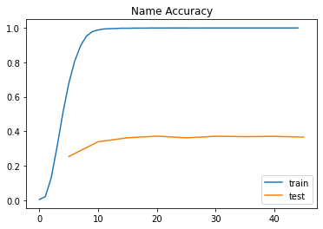
Results for Four Hundred Word Samples

Slide 8
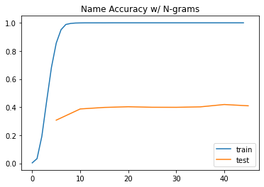
Results for Four Hundred Word Samples

Slide 9
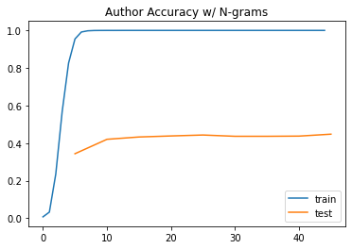
Results for Four Hundred Word Samples

Slide 10
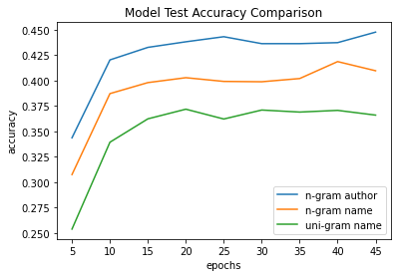
Results for Four Hundred Word Samples

Slide 11
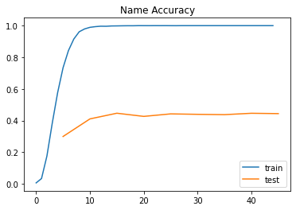
Results for Five Hundred Word Samples

Slide 12
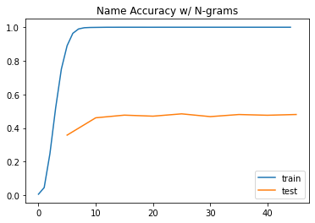
Results for Five Hundred Word Samples

Slide 13
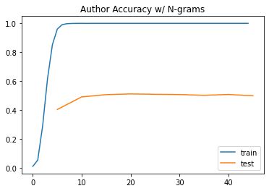
Results for Five Hundred Word Samples

Slide 14
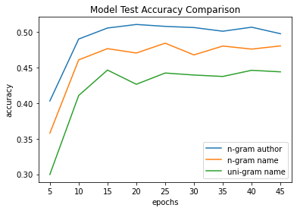
Results for Five Hundred Word Samples

Slide 15
results
Uni-gram Name = 54.5%
Multi-gram Name = 52.3%
Multi-gram Author = 51.6%

Slide 16
Recommendations
Determine predictive category
Determine optimal sample size
Create user-based categories

Slide 17
Questions
Are there specific authors harder to predict than others?
Are author prediction and book prediction really different or different names for the same target?
Other than tfidf vectorization were other methods attempted?
Why was tfidf vectorization used?
Can specific features be identified?

Slide 18
Questions
What are the benefits of using the model if accuracy rates are low?
Why were names and authors selected as target variables?
What are some categories that would be ideal for prediction?
Why does the model perform better for authors than names?
What steps would you suggest next?

